Slide 1

Agents with Tool Use
Apoorv Vishnoi
Head of Training, Analytics Vidhya
Notes:
Hi Everyone, In the previous lesson, we explored Sequential Chat and built a marketing strategy agent to help plan our launches.
In this lesson, we will explore "Tool Use," a feature that allows agents to utilize additional functionalities and external resources. Agents powered by large language models (LLMs) are highly capable and can handle complex problems and advanced tasks. However, on their own they can’t access real-time information or perform mathematical calculations, or search the web.this flexibility also presents challenges such as limited access to real-time information, and limited capability to perform mathematical calculations or search the web.

Slide 2
Agents with Tool Use
Tools help agents by providing:
Real-time access to relevant data using APIs
Accessing complex functions related to calculations and other tasks
Search through the web
Notes:
Tools help agents by providing them:
Real-time access to relevant data using APIs
Accessing complex functions related to calculations and other tasks. And in
Searching through the web.

Slide 3


AG2 Allows Integrating External Pre-Built Tools
Helps in tasks such as: Web Scraping, Database Integrations
Notes:
While AG2 currently does not have pre-built tools of its own, it allows users to integrate popular tools from other agentic frameworks like LangChain and CrewAI. These tools add immense value for tasks such as file operations, web scraping, database interactions, API integrations, and even image or audio generation.
Using pre-built tools is an efficient way to enhance our agents’ capabilities, however, there are times when we need a tool tailored to our specific task. AG2 also allows users to create their own tools within its framework through a straightforward process. Let’s take a step-by-step dive into the process of building a tool in Autogen,

Slide 4
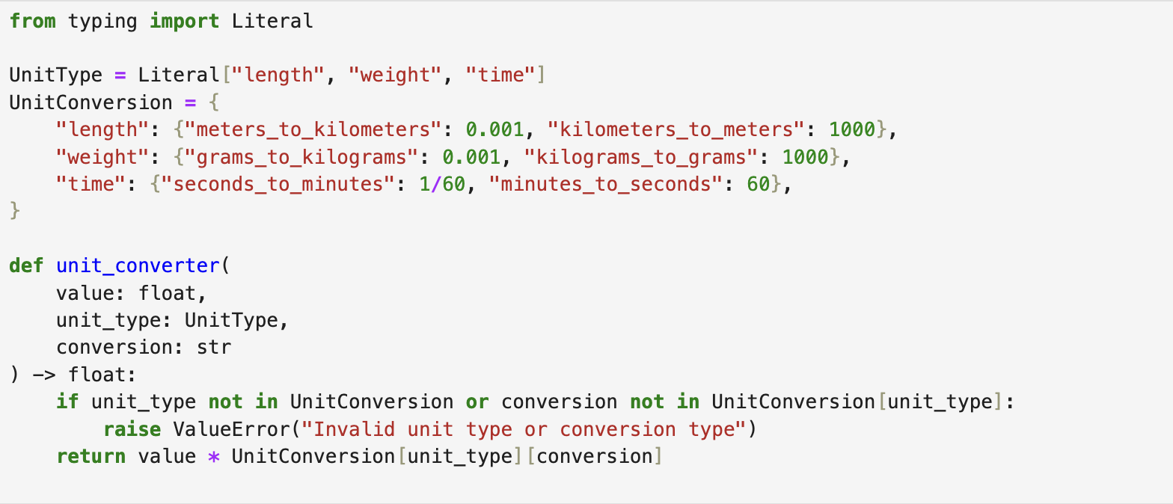
Steps to Build Tool in AutoGen
Step 1: Tool Creation
Notes:
The first step is creating a tool. The creation of a tool can be as simple as creating a custom function in Python. Like the one shown here. The unit_converter function converts a given value between specified units (length, weight, time) using predefined conversion rates.

Slide 5
Steps to Build Tool in AutoGen
Step 2: Registering the Tools
Notes:
Once the tool is created, the next step is to register it with the agents. This allows agents to understand how to call the tool during conversations and how to execute the tool and return the results. There are three ways in which you can register a tool.

Slide 6
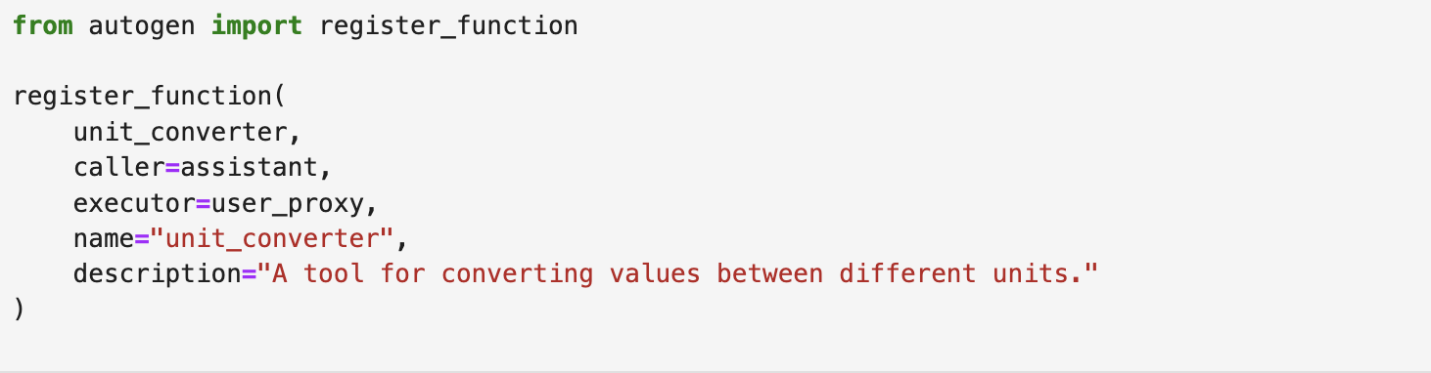
Steps to Build Tool in AutoGen
Step 2(a): Registering the Tools
Notes:
In the first one, you can use the register_function from Autogen and specify the caller and executor for the tool. Based on the prompt query the caller identifies whether the tool should be used. If the tool is supposed to be used then the executor runs the tool. The same agent can act as both caller and executor as well.

Slide 7
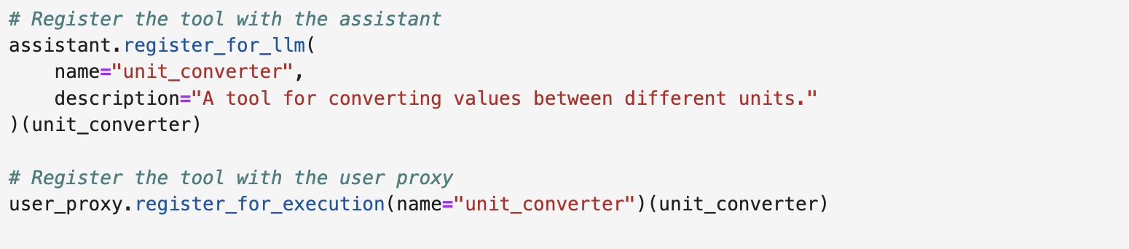
Steps to Build Tool in AutoGen
Step 2(b): Registering the Tools
Notes:
In the second method, you can use the attribute, register_for_llm of the caller agent followed by using register_for_execution attribute of the executor to execute the tool. Here assistant agent can be used to call the tool while User Proxy agent can be used to execute the tool.

Slide 8
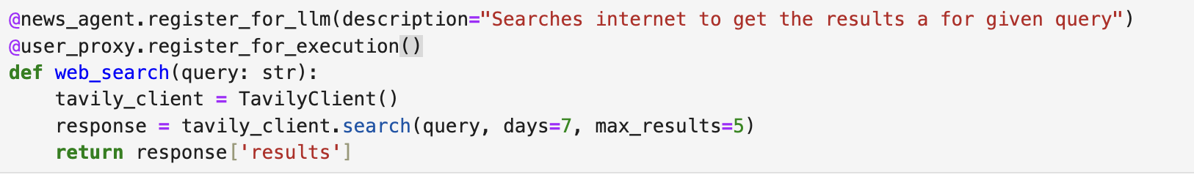
Steps to Build Tool in AutoGen
Step 2(c): Registering the Tools
Notes:
The third method is using decorators. A decorator is a Python feature that allows you to modify or extend the behavior of a function or method. When you place @decorator_name above a function, Python passes the function to the decorator before it executes the function. In our example, the web_search function is registered as a tool with the news_agent as the caller and the user proxy as the executor.

Slide 9
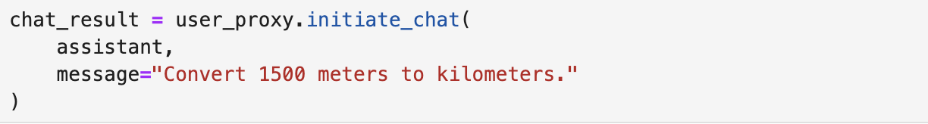
Steps to Build Tool in AutoGen
Notes:
Once the tool is registered, it becomes part of the agent’s capabilities and can be called based on the prompt. For example- the unit converter tool will be used in this distance conversion prompt.

Slide 10
Applications of Tool Use in AutoGen
Applications of Tool Use
Data Processing
File Management
API Integrations
Notes:
With this knowledge, you can extend the concept of tools beyond simple operations to handle more complex workflows, such as data processing, file management, and API integrations. In simple terms, tools make agents smarter.

Slide 11
Thanks!
Notes:
Head to the next lesson, where we get to build a daily newsletter agent using a sequential pattern. We will use both a pre built tool and a custom built tool in this notebook. See you in the next video.

Slide 12
Limitations of Agents
LLM Powered Agents are highly capable but has its challenges:

Slide 13
Limitations of Agents
LLM Powered Agents are highly capable but has its challenges:
Limited Access to Real-Time Information
Poor at Mathematical Calculations and Web Search
Not all LLMs support Tool Use
Notes:
Also, raise the not all LLMs support tool use.

